Slide 1
EU Agencies
Triviño and Jordana

Slide 2
Authors’ Background
Juan Carlos Triviño
Researcher at the Institut Barcelona d’Estudis Internacionals (IBEI)
Focuses on EU governance and public administration
Jacint Jordana
Professor of political science at Universitat Pompeu Fabra
Senior researcher at IBEI
Expert in regulation, public policy, and EU institutions

Slide 3
What are EU Agencies?
EU agencies are organizations created to assist the EU in implementing specific policies on issues like health, the border, and finance.
Ex: Frontex handles borders, European Medicines Agency (EMA) handles medicines
Why do they exist?:
The European Union needed help managing complex problems.
EU countries and institutions don’t always agree.

Slide 4
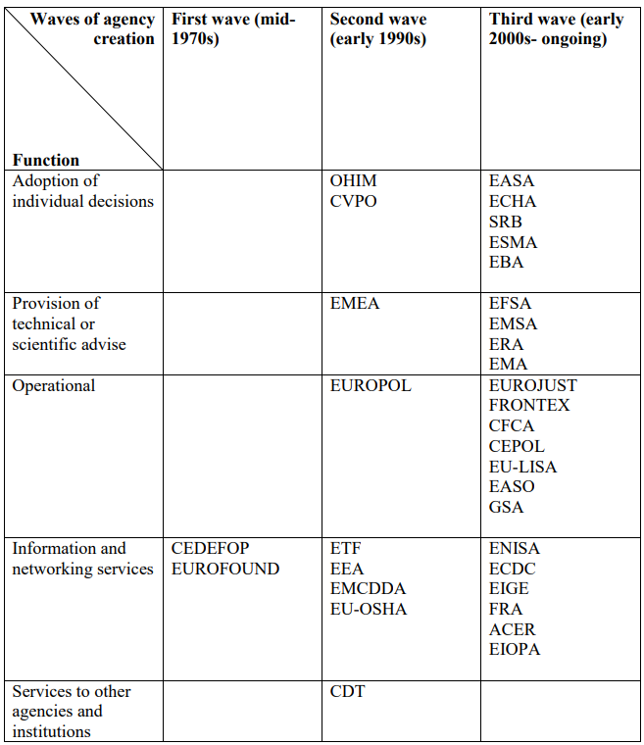
Creation of EU agencies through waves and functions
First Wave (1970s) - Focused mainly on providing information and basic support to EU institutions.
Second Wave (1990s) - Include more technical expertise and coordination roles as EU policies became more complex.
Third Wave (2000s - present) - Taken on more operational and regulatory responsibilities, especially in response to crises.

Slide 5
Independence vs Control
A central debate is whether these agencies act independently or remain under the control of EU institutions and member states.
They are designed to be independent, but in practice, they are constrained by EU actors.
De jure autonomy - legal independence
De facto autonomy - real-world independence
Principal-Agent Theory - Suggests agencies are delegated tasks but closely monitored, meaning their autonomy is limited.

Slide 6
Authors’ Suggestions
Study what agencies actually achieve and whether they improve policy outcomes.
Study their coordination role more.
Consider the role of external actors and informal decision-making
Better understand multi-level governance

